Slide 1
NEURAL MACHINE TRANSLATION BY JOINTLY LEARNING TO ALIGN AND TRANSLATE
Dzmitry Bahdanau, KyungHyun Cho, Yoshua Bengio

Slide 2
Introduction
Unlike Statistical Machine Translation, Neural Machine Translation(NMT) aims to train a neural network
Recently proposed approaches in NMT belong to a family of encoder and decoder that encodes a source sentence into a vector representation from which decoder generates a translation
Notes:
Statistical Machine Translation is an approach where translations are generated on the basis of statistical models whose parameters are derived from the analysis of bilingual text corpora
Neural Machine Translation is an emerging topic that aims to train a neural network

Slide 3
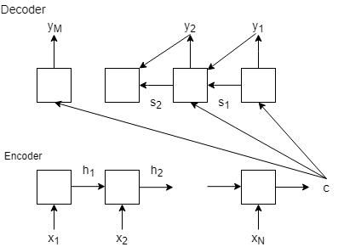
Introduction
Bottleneck:
Information of source sentence is compressed into one fixed vector
Cho et al. (2014b) showed performance of a basic encoder–decoder deteriorates rapidly as the length of an input sentence increases.
In this paper, an extension to the encoder-decoder model that jointly aligns and translate is proposed
RNN Encoder-Decoder architecture
Notes:
A potential issue with this encoder–decoder approach is that a neural network needs to be able to compress all the necessary information of a source sentence into a fixed-length vector
Each time the proposed model generates a word in a translation, it (soft-)searches for a set of positions in a source sentence where the most relevant information is concentrated.

Slide 4

Background
Machine Translation tries to find a target sequence $y$ that maximizes conditional probability of target sentence given a source sentence $x$
$$argmax_{y} P\left(y \right| x )$$
Neural Machine Translation fits a neural network model to maximize this conditional probability
In the literature, (Kalchbrenner and Blunsom, 2013; Cho et al., 2014a; Sutskever et al., 2014; Cho et al., 2014b; Forcada and Neco, 1997)

Slide 5

Background
Neural network approach consists of two components: Encoder and decoder. The former encodes a source sentence $x$ and the latter decodes to a target sentence $y$.
Cho et. al(2014a) and Sutskever et. al(2014) used RNNs for both encoder and decoder.
Sutskever et al. (2014) reported that RNNs with LSTM units achieves close to the state-of-the-art performance of the conventional phrase-based machine translation system on an English-to-French translation task

Slide 6
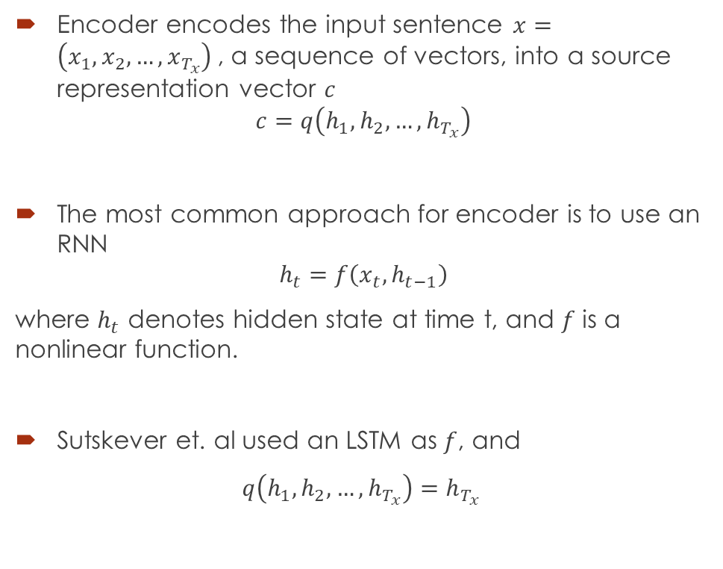
RNN Encoder - Decoder
Encoder encodes the input sentence $x=\left(x_{1}, x_{2}, …,x_{T_{x}}\right)$, a sequence of vectors, into a source representation vector $c$
$$c=q\left(h_{1},h_{2},…, h_{T_{x}}\right)$$
The most common approach for encoder is to use an RNN
$$h_{t}=f\left(x_{t}, h_{t−1}\right)$$
where $h_{t}$ denotes hidden state at time t, and $f$ is a nonlinear function.
Sutskever et. al used an LSTM as $f$, and
$q\left(h_{1},h_{2},…, h_{T_{x}}\right)=h_{T_{x} }$
Figure: RNN Encoder-Decoder Architecture

Slide 7
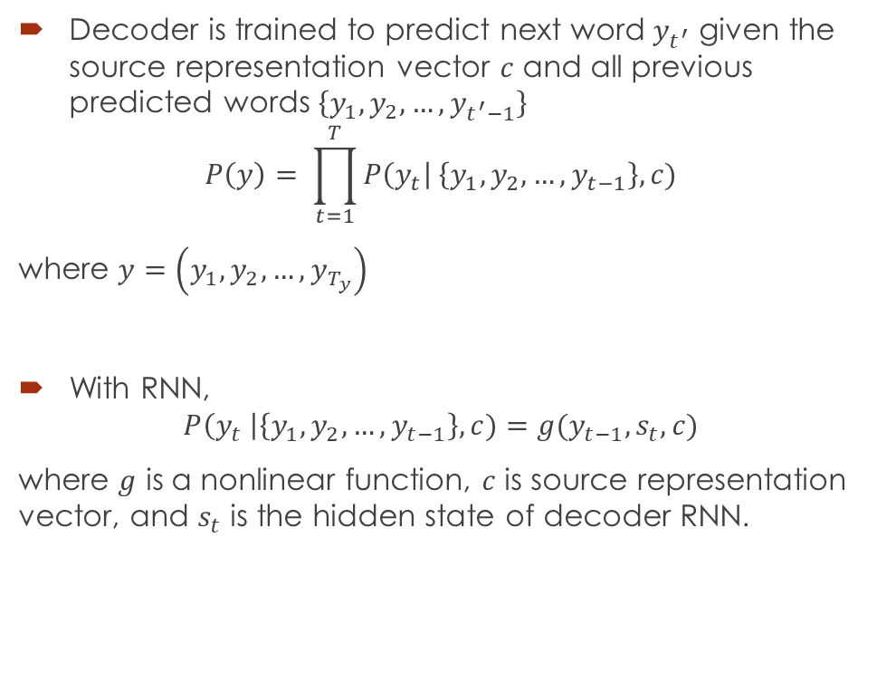
RNN Encoder - Decoder
Decoder is trained to predict next word $y_{t^{′}}$ given the source representation vector $c$ and all previous predicted words $\left\{y_{1},y_{2}, …, y_{t^{′}−1}\right\}$
$$P\left(y\right)= \prod_{t=1}^{T}{P\left(y_{t}\right| \left\{y_{1}, y_{2}, …, y_{t−1}\right\}, c)}$$
where $y=\left(y_{1}, y_{2}, …, y_{T_{y}}\right)$
With RNN,
$$P\left(y_{t} \right|\left\{y_{1},y_{2}, …, y_{t−1}\right\}, c)=g(y_{t−1}, s_{t}, c)$$
where $g$ is a nonlinear function, $c$ is source representation vector, and $s_{t}$ is the hidden state of decoder RNN.
Notes:
the decoder defines a probability over the translation y by decomposing the joint probability into the ordered conditionals

Slide 8

Learning to Align and Translate
Novelties of decoder:
Soft alignment of context vector $c_{t}$ for a set of positions in a source sentence where the most relevant information is concentrated
Use of Gated Recurrent Unit proposed by Cho et. al as activation function
Notes:
A decoder that searches through a source sentence to capture most relevant information

Slide 9
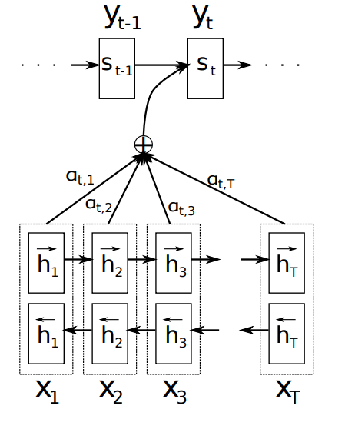

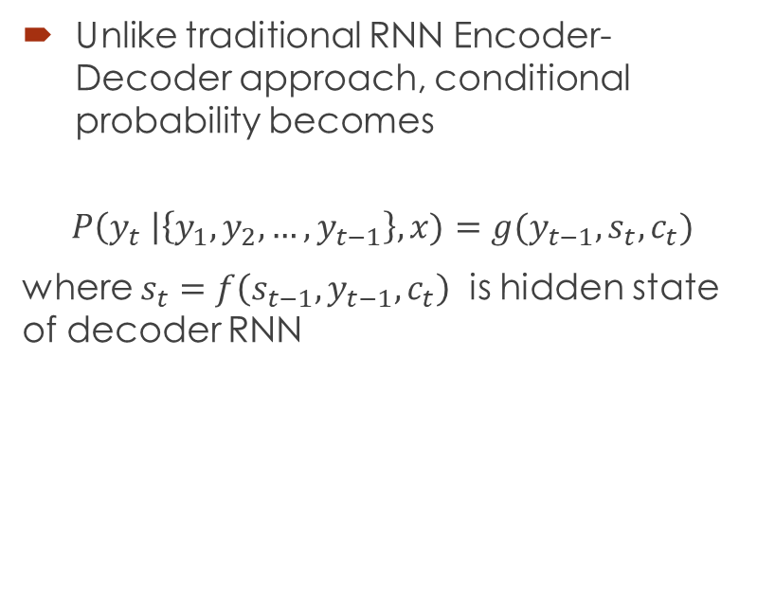
Decoder
Unlike traditional RNN Encoder-Decoder approach, conditional probability becomes
$$P\left(y_{t} \right|\left\{y_{1},y_{2}, …, y_{t−1}\right\}, x)=g(y_{t−1}, s_{t}, c_{t})$$
where $s_{t}=f\left(s_{t−1}, y_{t−1}, c_{t}\right)$ is hidden state of decoder RNN
Figure: Decoder RNN architecture
Notes:
In the prediction of next word yi, instead of using fixed source representation, we define a context vector searches through source hidden states(annotations)
Now I’m going to explain how this information is generated from these annotations

Slide 10

Decoder
Context vector $c_{t}$ depends on a sequence of annotations ${(h}_{1}, h_{2}, …, h_{T_{x}})$ which an encoder maps input sentence
The context vector $c_{i}$ aligns target position $i$ with input sequence as weighted sum of annotations
$$c_{i}= \sum_{j=1}^{T_{x}}{α_{ij}h_{j} }$$
where weights are chosen according to importance of annotation $h_{j}$.
Notes:
The encoder consists of bidirectional LSTM and by concatenating forward and hidden states we generate annotations
The context vector is weighted sum of these annotations according to some defined weights instead of depending on last hidden state as in RNN Encoder-Decoder

Slide 11

Decoder
Weights for target position $i$ are chosen according to softmax of alignment scores $e_{ij}$
$$α_{ij}= \frac{exp⁡(e_{ij})}{\sum_{k=1}^{T_{x}}{\exp\left(e_{ik}\right) } }$$
where
$$e_{ij}=a\left(s_{i−1}, h_{j}\right)$$
is an alignment model which gives a score of how well input around position $j$ and output around position $i$ match.
In decoder RNN model,
$$s_{t}=f\left(s_{t−1}, y_{t−1}, c_{t}\right)$$
$s_{t−1}→ α_{t} →{ c}_{t} →s_{t}$
Notes:
The weights are calculated as softmax of alignment scores of target word i which in the end generates probabilities from 0 to 1. And we use these probabilities as weights
Alignment score means correlation of target hidden state I and input annotation j.
These hidden states carry information of words around their local position in two ways due to bidirectional LSTM

Slide 12

Decoder
The alignment function $a$ is given as single-layer perceptron such that
$$e_{ij}= a\left(s_{i−1}, h_{j}\right)=v_{a}^{T}\tanh\left(W_{a} \left[s_{i−1}; h_{j}\right]\right)$$

Slide 13

Decoder
For the activation function $f$ of decoder RNN, Gated Recurrent Unit proposed by Cho et. al(2014a) is used.
The initial hidden state of decoder RNN is computed as
$$s_{0}=tanh⁡(W_{s} \overset{⃐}{h_{1}})$$

Slide 14
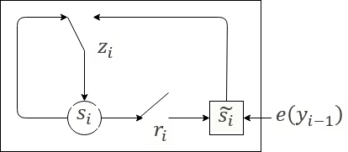
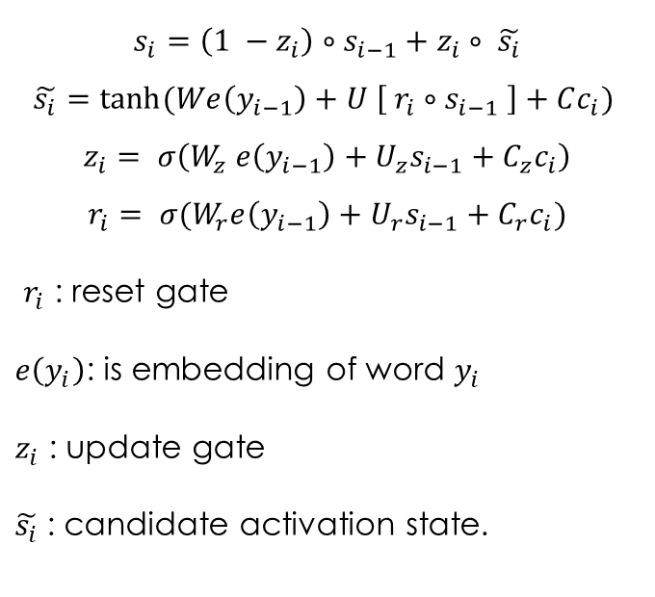
Gated Recurrent Unit (GRU)
$$s_{i}=\left(1 −z_{i}\right)∘s_{i−1}+z_{i}∘ \tilde{s_{i}}$$
$$\tilde{s_{i}}=tanh⁡(We\left(y_{i−1}\right)+U \left[ r_{i}∘s_{i−1} \right]+Cc_{i})$$
$$z_{i}= σ\left(W_{z} e\left(y_{i−1}\right)+U_{z}s_{i−1}+C_{z}c_{i}\right)$$
$$r_{i}= σ(W_{r}e\left(y_{i−1}\right)+U_{r}s_{i−1}+C_{r}c_{i})$$
$r_{i}$ : reset gate
$e\left(y_{i}\right)$: is embedding of word $y_{i}$
$z_{i}$ : update gate
$\tilde{s_{i}}$: candidate activation state.

Slide 15
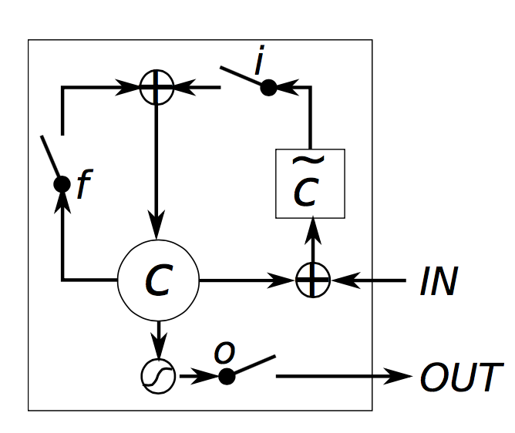


GRU vs LSTM
GRU architecture
LSTM architecture

Slide 16
GRU vs LSTM
GRU has 2 gates, LSTM has 3 gates
No second nonlinearity to compute the output
GRU has less parameters
Notes:
Less parameters

Slide 17
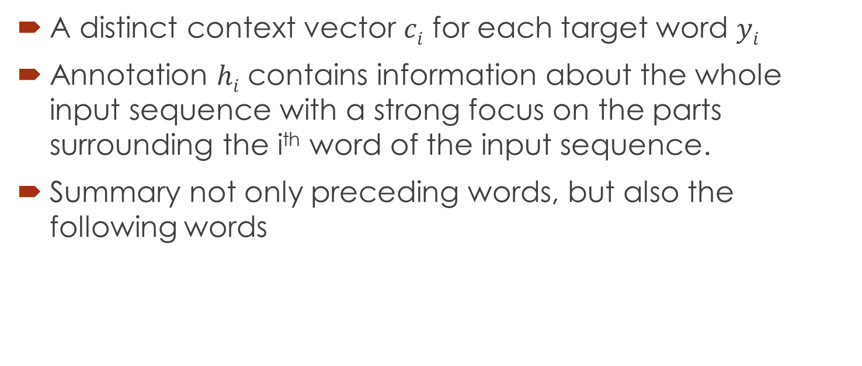
Encoder
A distinct context vector $ci$ for each target word $yi$
Annotation $hi$ contains information about the whole input sequence with a strong focus on the parts surrounding the i^{th} word of the input sequence.
Summary not only preceding words, but also the following words

Slide 18
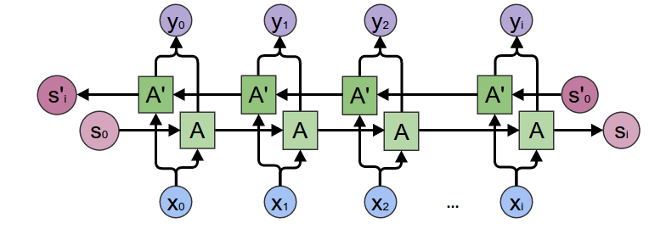
Encoder: Bidirectional RNN
Scan the input sequence in both direction, forward and backward

Slide 19
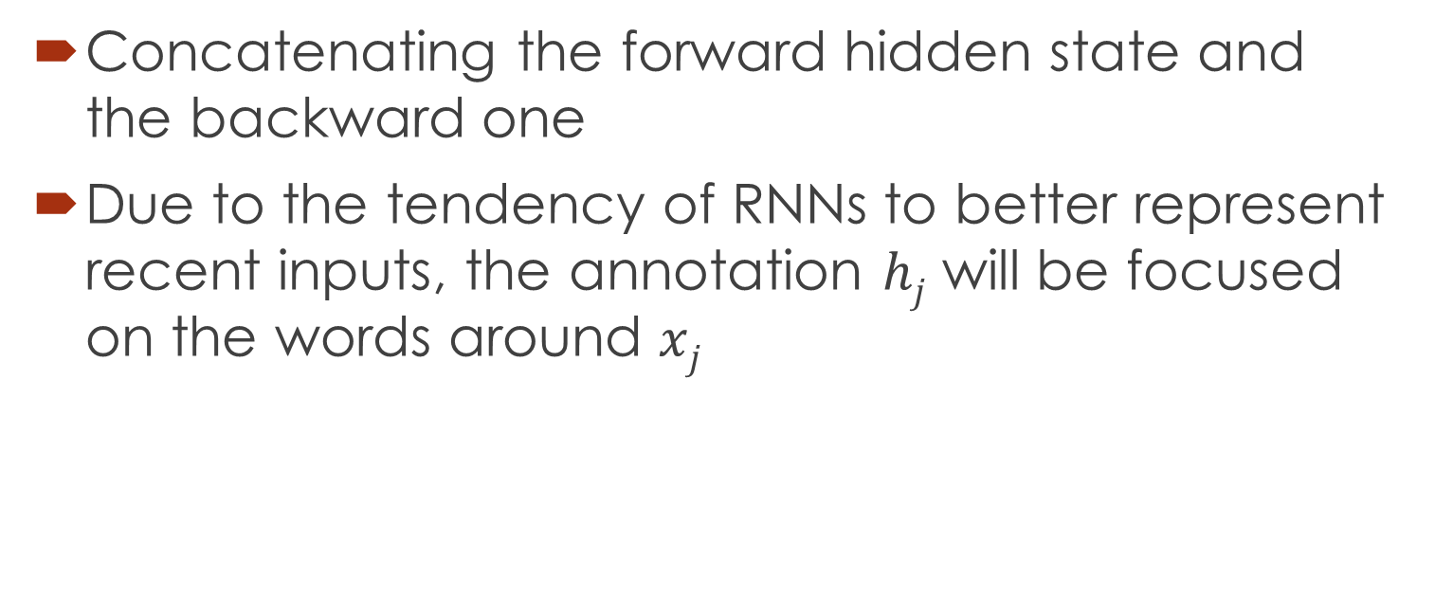
Encoder: Bidirectional RNN
Concatenating the forward hidden state and the backward one
Due to the tendency of RNNs to better represent recent inputs, the annotation $hj$ will be focused on the words around $xj$

Slide 20
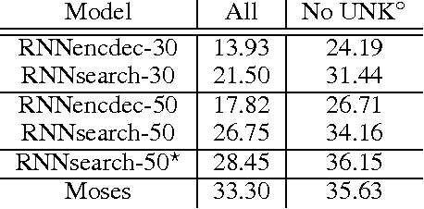
Quantitative Results
Baseline: RNN Encoder-Decoder (RNNencdec, Cho et al., 2014)
Moses: a conventional phrase-based translation system
Dataset: ACL WMT ’14 English-to-French, 850M words
Tokenization: Top 30,000 most frequent words

Slide 21
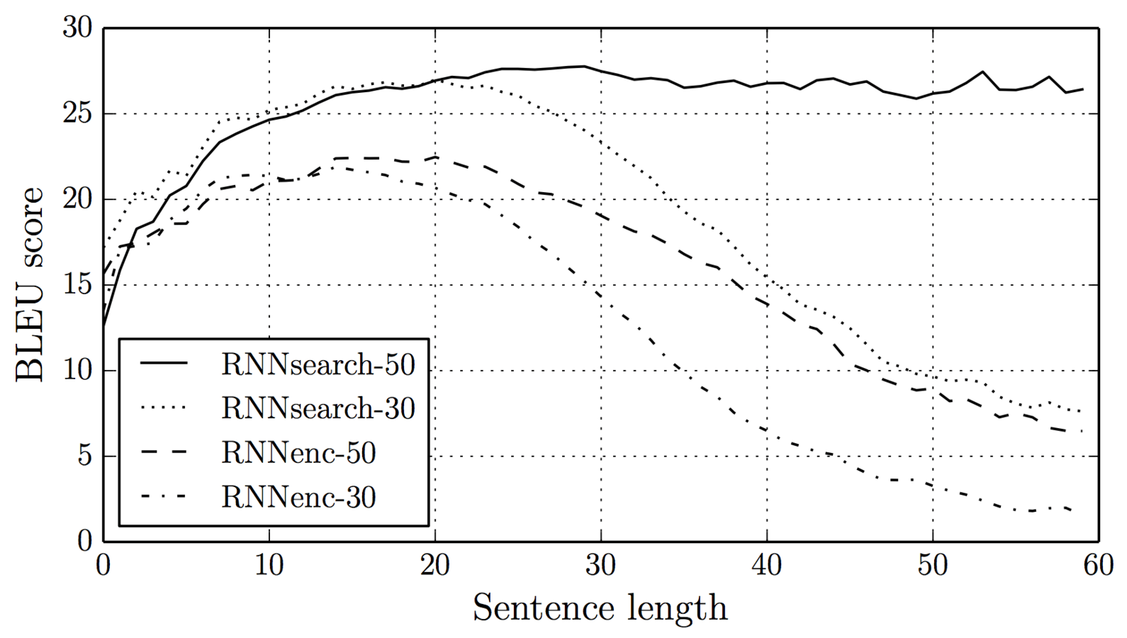
Experiment
No deterioration even with sentences of length 50 or more!

Slide 22
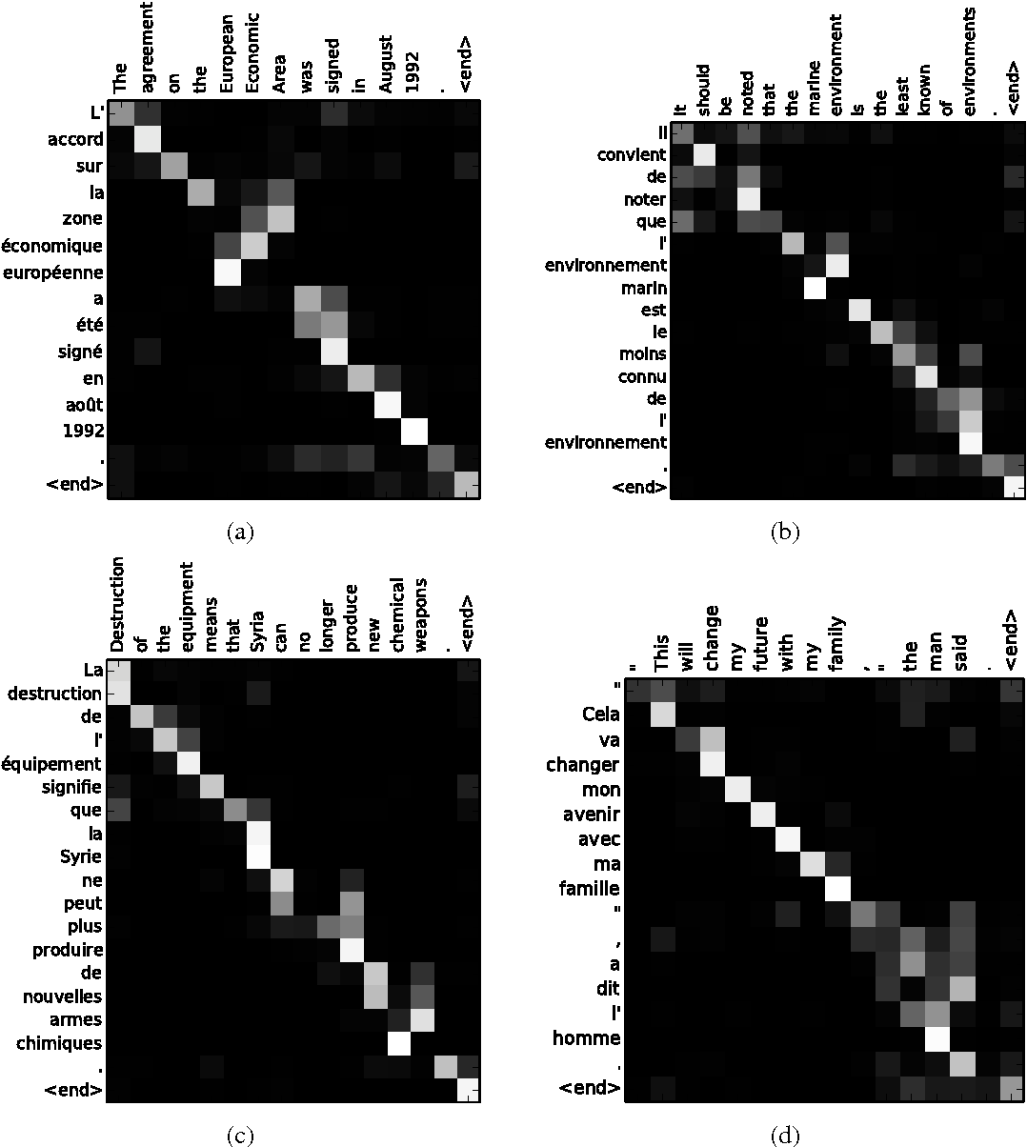
Qualitative Analysis: Alignment

Slide 23
Conclusion
Conventional approach encodes a whole input sentence into a fixed-length vector, limitation for translation long sentences
Attention Mechanism: (soft-)search for a set of input words, or their annotations computed by an encoder, focus only on information relevant to the generation of the next target word
Achieved a translation performance comparable to the existing phrase-based statistical machine translation

